Slide 1
Employee Data Analysis using Excel
STUDENT NAME: POOJA.R
REGISTER NO: 122203543
DEPARTMENT: B.COM( CORPORATE SECRETARYSHIP)
NANMUDHALVAN : asunm1475122203543
COLLEGE: SRI KANYAKA PARAMESWARI ART'S &SCIENCE COLLEGE FOR WOMEN

Slide 2
PROJECT TITLE
Employee Performance Analysis using Excel

Slide 3


AGENDA
Problem Statement
Project Overview
End Users
Our Solution and Proposition
Dataset Description
Modelling Approach
Results and Discussion
Conclusion
3/21/2024 Annual Review

Slide 4

PROBLEM STATEMENT
with the introduction of our latest software update,while many Features were enhanced,we have observed a 12% decline in user activity during the first hour of usage. This is suggestive of a potential usability or interface challenge that might be hindering the user experience especially for those familiar with the previous version

Slide 5

PROJECT OVERVIEW
.
Excel uses a large collection of cells formatted to organize and manipulate data and solve mathematical functions. Users can arrange data in the spreadsheet using graphing tools, pivot tables and formulas. The spreadsheet application also has a macro programming language called Visual Basic for Applications.

Slide 6

WHO ARE THE END USERS?
The user refers broadly to anyone who may use or maintain a product, and could include people such as system administrators, IT experts, and computer technicians. The end-user is the person ultimately intended to use a product

Slide 7

OUR SOLUTION AND ITS VALUE PROPOSITION
Save your E
A value proposition should clearly explain how a product fills a need, communicate the specifics of its added benefit, and state the reason why it's better than similar products on the market. The ideal value proposition is to-the-point and appeals to a customer's strongest decision-making drivers

Slide 8
Dataset Description
Data sets are configurable objects that store your data (think of them as Excel worksheets, or database tables, or tabular lists). You can give each data set a name, define its columns, set user permissions, and import data.

Slide 9

THE "WOW" IN OUR SOLUTION
1. Data Analysis and Visualization: Excel offers powerful tools for analyzing data, including functions, pivot tables, and charts. These features can help you uncover insights and present data in a visually appealing way.
2. Automation with Macros: Excel macros allow you to automate repetitive tasks, saving time and reducing the risk of errors.
3/21/2024 Annual Review

Slide 10
MODELLING
Work Location preference: pie chart showing the percentage of employee preferring office,remote,or hybrid work.
Satisfaction scores by department: Bar chart comparing average satisfaction score across different department.
Benefits importance: Column chart displaying the importance of various benefits according to employee preference

Slide 11
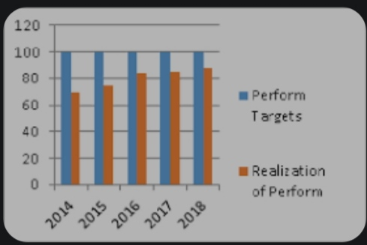
RESULTS

Slide 12
conclusion
The insights derived from this analysis understand the importance of aligning organization practice with employees preference by acting on these finding organization can enhance employee satisfaction,improve retention and create a more positive and productive work environment

